Slide 1
Skin Cancer
Cusack, Matthew; Lewis, Krystal; Moore, Tasha; Rotich, Solomon
Part 2

Slide 2
The Data
Skin Cancer MNIST DenseNet
Python · Skin Cancer MNIST: HAM10000
Notes:
The motivation for this project is to create a visual representation of the correlations between skin cancer in relation to age, sex and localization. This will serve as ways, common types of skin cancers, have been identified and on the most common places on the body. The data was taken from Kaggle using a data set created for a CNN model. Sampling over 800 people who have been diagnosed of skin cancer.

Slide 3
Types of
Skin Cancers
Melanocytic Nevi
Melanoma
NV
MEL
Benign keratosis
Basal Cell Carcinoma
BLK
BCC
Actinic Keratoses
and intraepithelial carcinoma
vascular lesions
AKIEC
vasc
Notes:
During this presentation this we will discuss several different types of skin cancers. They will, at times, be referred to for either their direct names or abbreviation of the different types of cancers.

Slide 4
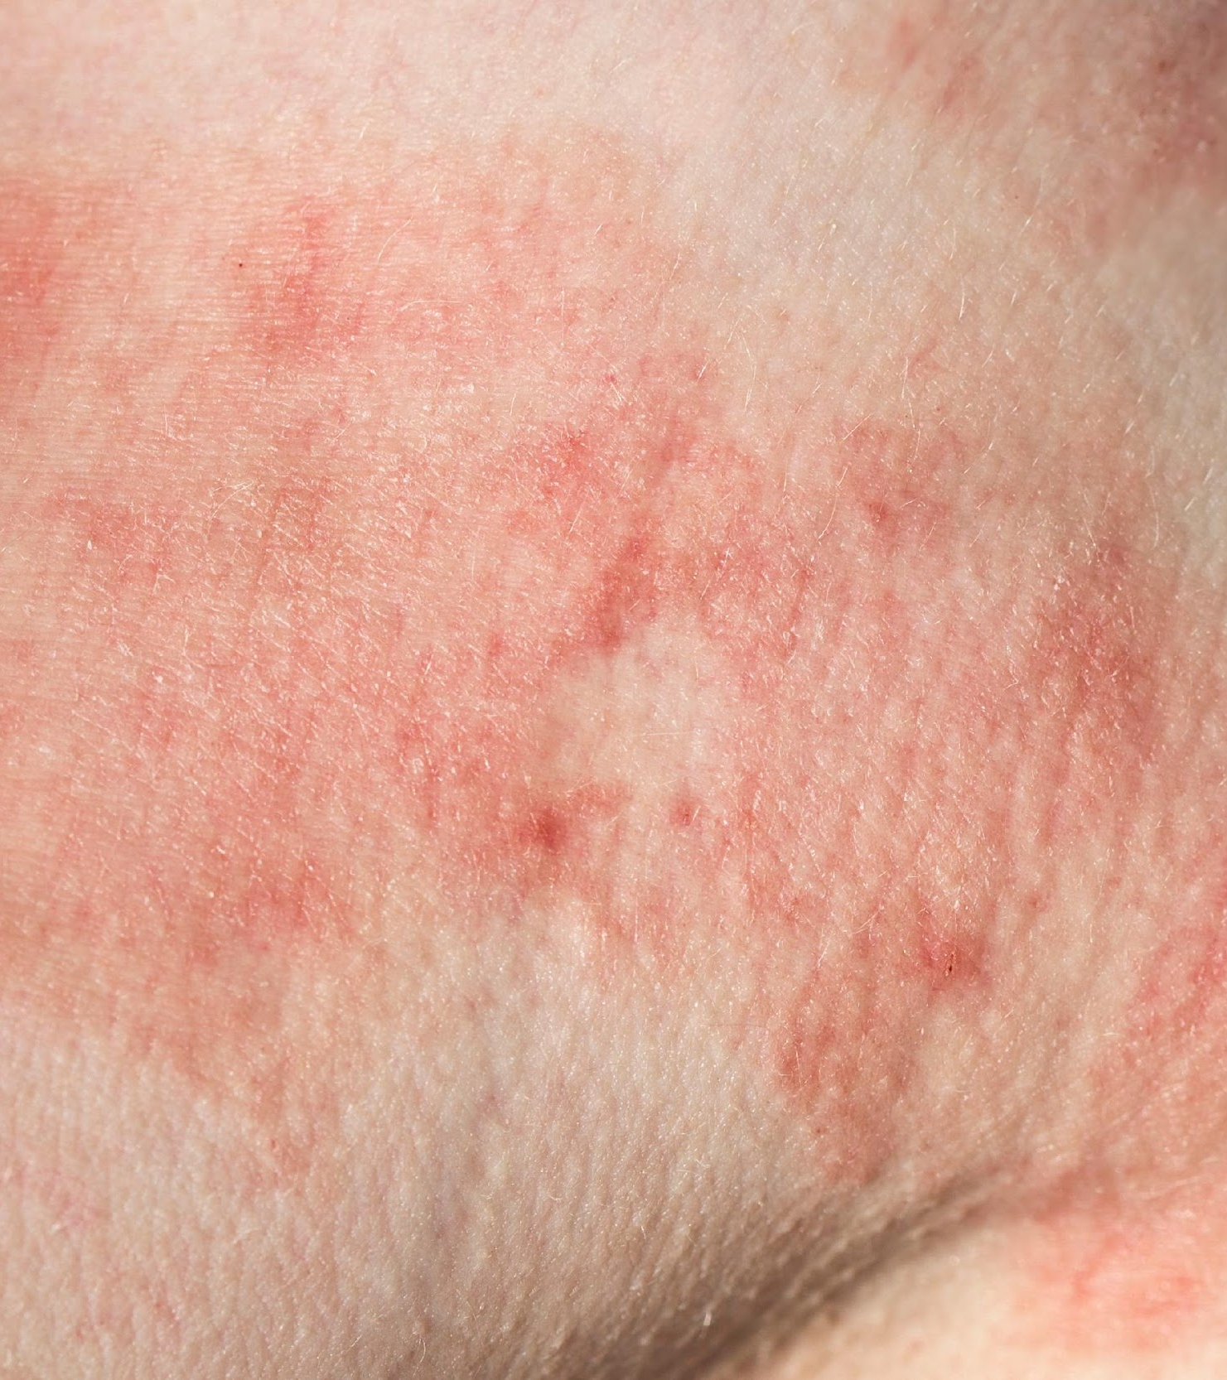
What does the data say?
SEX
Diagnosis
Is age an
determining
factor in
skin cancer risk?
Localization

Slide 5
Null Hypothesis
(HO)
Alternate Hypothesis
(H1)
There is no relationship between the sex of an individual and the age at which they are diagnosed?
There is a direct relationship between the sex of a patient and the age at which they are diagnosed with skin cancer.
Notes:
Null : There is no relationship between the sex of the patient and the age at which they are diagnosed with skin cancer
Alternate : There is a relationship between the sex of a patient and the age at which they are diagnosed with skin cancer.
-Females are more likely to be diagnosed with skin cancer at an earlier age than males.

Slide 6
Null and Alternative chart

Slide 7
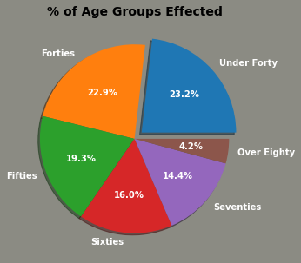
Notes:
So let take a look at ages. within the data, included was a wide range of ages. When analysing the data we noticed that the under 40 categories were minute so we decided to group that data together to create cleaner, more readable data. We can now identify that the under 40 age group accounts for the highest affected cases. while individuals in their 40 are less than a point difference. Alternatively, individuals over 80 is the smallest group affected,. Now lets break this down a bit further.

Slide 8
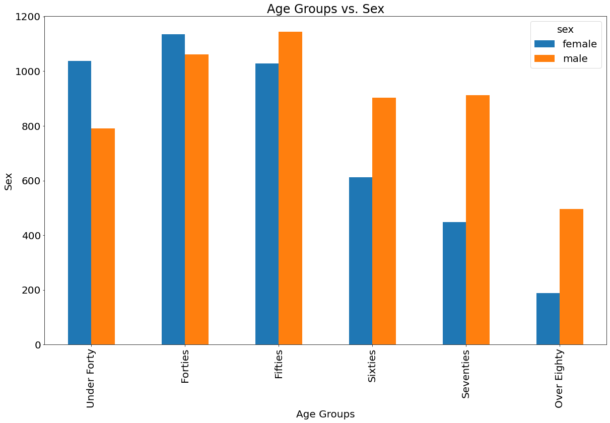
Notes:
The graph of Age vs. Sex shows a decrease in counts as age increases.
Other than the younger groups of under forty and forties, females seem to have a higher count than males.

Slide 9
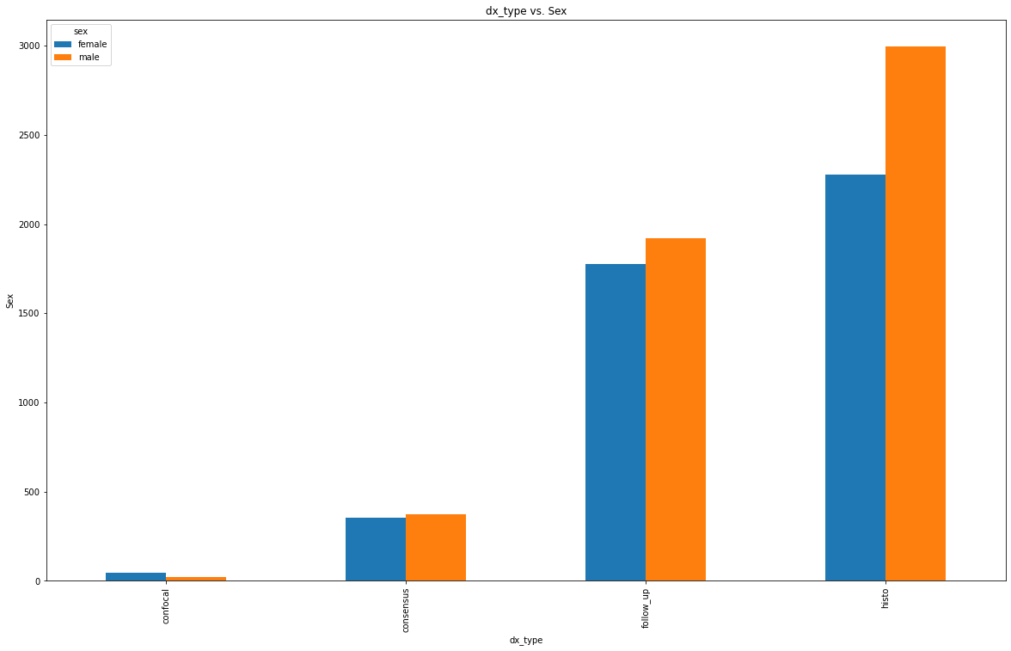
Notes:
One of the susuquestial questions that arose when analysing the data was the link between diagnosis type and the sex of the patients. While in the previous chart we saw that more females were diagnosed than males, this chart is a stark difference. When analysing the types of skin cancer the data shows that males are more likely to

Slide 10
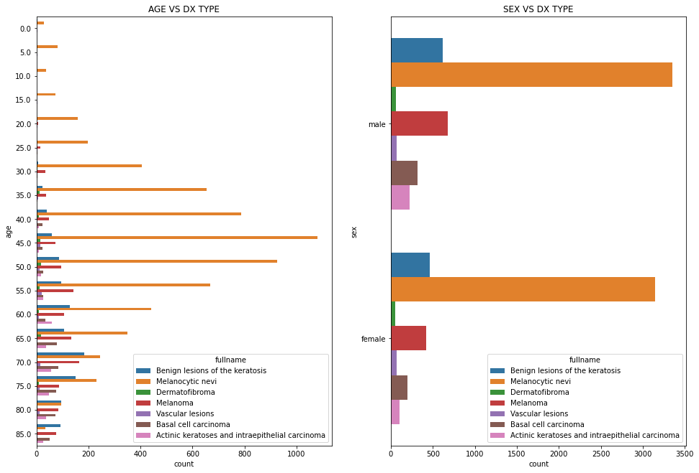
Notes:
According to the data, Melanocytic nevi effect the majority of both men and women in all age groups except the over 80 age group. They are most affected by Benign keratosis.

Slide 11
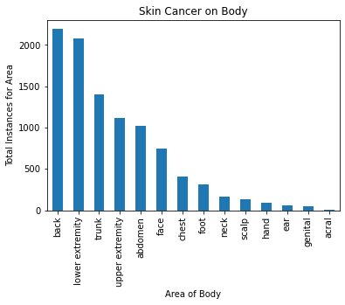
Back
Trunk
Upper Extremities
Abdomen
Lower Extremities
Notes:
skin cancer incompases the entire body, however when going through the data we determined that the top five most affected areas of the body the back at more that 2000 cases, the lower extremities right at 2000, the trunk on a decline to roughly 1400 cases, the upper extremities around 1350 andthe abdomen around 1200. After analysing the data we notice a steep decline in areas of the body that received less uv rays.

Slide 12
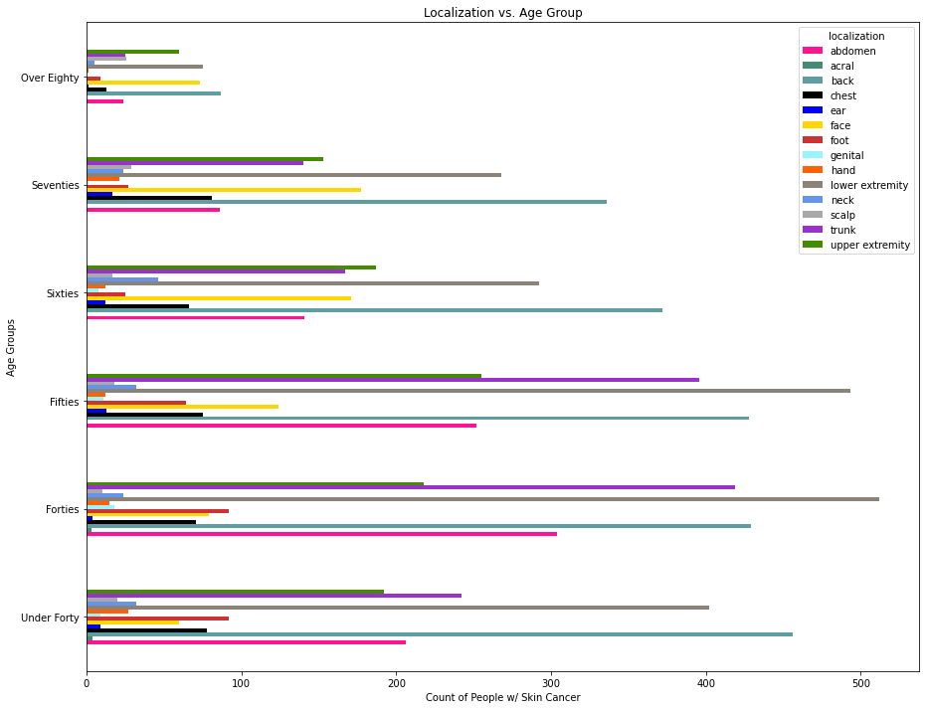
Notes:
Upon analysing more of the data we have determined that the localization of many of the age groups vary widely. There is a close resemblance in the 60’s and 70 as far as location or localization of the skin cancer. The back and Lower extremities in any age group have the highest occurrence.

Slide 13
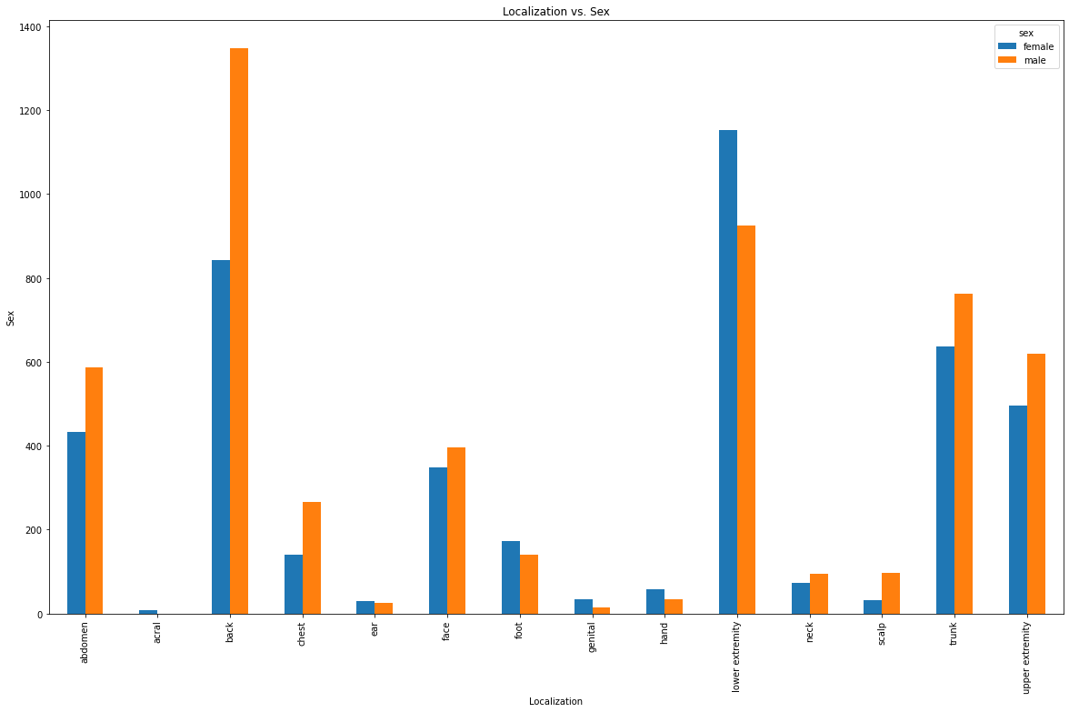
Notes:
Here we have Localization determined by gender. Males have a high occurrence in their backs, trunks lower extremities and abdomen while females feet, hands and lower extremities are higher.

Slide 14
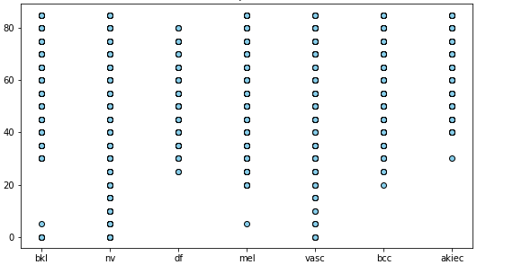
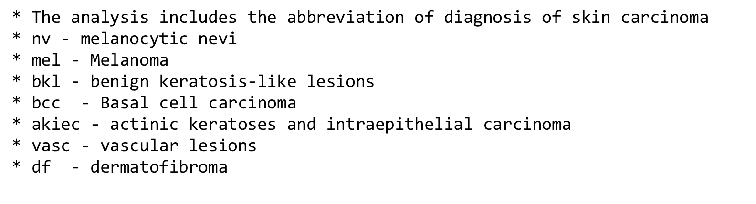
Number of occurrences
Type of skin cancer
Notes:
From the graph (diagnosis type vs age) the number of datapoints for bkl,df, bcc and akiec skin cell type lesions seems to be less prevalent below the age of 20 years as compared to over age 60 and above.

Slide 15
Final
Summary
We found that age is not a true determinant in skin cancer.
The most common type of skin cancer among any age group was Melanocytic nevi in both male and female.
The more dominant location for skin cancer in the Back of the body followed very closely by the lower extremities.
women ……
Notes:
In conclusion the analysis determined 3 major finding. That age is not a true determining factor-However the data show that the age group “Forty” had the more prominent risk.
, both male and female alike are at higher risk of Melanocytic (melon o sis tic), the most common are are the back and lower extremities

Slide 16

Cited
RESOURCES
Data Source :
Kaggle
Skin Cancer MNIST: HAM10000 | Kaggle
CDC
:Skin Cancer Facts & Statistics - The Skin Cancer Foundation
Questions?
Photo Sources:
CDC
What Can I Do to Reduce My Risk of Skin Cancer? | CDC
ISIC Archive (isic-archive.com)
Envato Elements
Download 333 Skin Cancer Photos - Envato Elements

